Slide 1

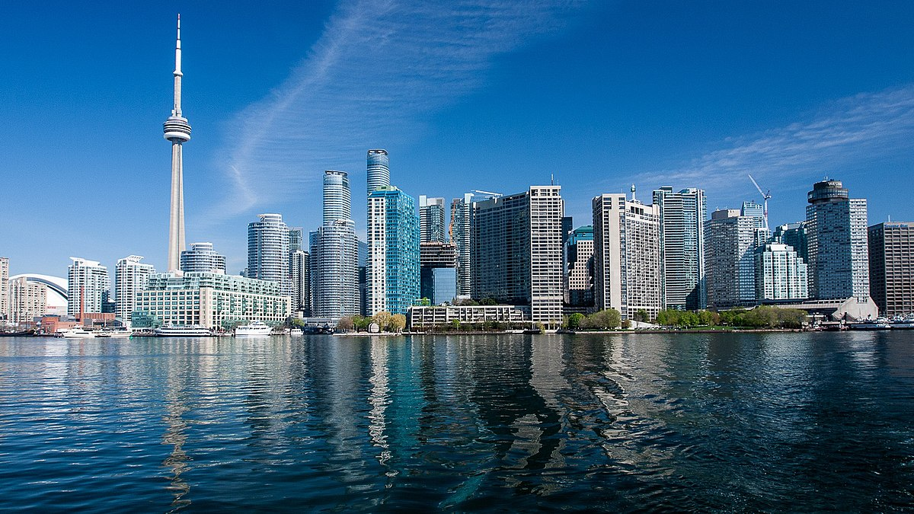
Caribbean Restaurant Project
David Rodriguez Castro
March,11,2021
Notes:
This template can be used as a starter file to give updates for project milestones.
Sections
Sections can help to organize your slides or facilitate collaboration between multiple authors. On the Home tab, under Slides, click Section, and then click Add Section.
Notes
Use the Notes pane for delivery notes or to provide additional details for the audience. You can see these notes in Presenter View during your presentation.
Keep in mind the font size (important for accessibility, visibility, videotaping, and online production)
Coordinated colors
Pay particular attention to the graphs, charts, and text boxes.
Consider that attendees will print in black and white or grayscale. Run a test print to make sure your colors work when printed in pure black and white and grayscale.
Graphics, tables, and graphs
Keep it simple: If possible, use consistent, non-distracting styles and colors.
Label all graphs and tables.

Slide 2

Project Overview
What is the project about?
Define the goal of this project
Define the scope of this project
Notes:
What is the project about?
Define the goal of this project
Is it similar to projects in the past or is it a new effort?
Define the scope of this project
Is it an independent project or is it related to other projects?
* Note that this slide is not necessary for weekly status meetings

Slide 3
Introduction
A restaurant with a Caribbean concept would be a great business opportunity in any city.
We are living difficult times in economic terms but a food business implies a commitment not only to the country where it is developed but also to promote the culture
London and Toronto are attractive cities for tourism and have a high cultural concentration, which could be the proposal I would like to recommend.

Slide 4
Project Overview
The project is about opening a Caribbean restaurant in a city far away from the Caribbean context.
The goal is to identify, using data science tools and resources, which city would be the most viable to open a Caribbean restaurant.
Based on the correct identification of the coordinates of both cities, categories of services will be identified to help identify which environment best suits the type of restaurant I plan to open

Slide 5
Business Problem
The business opportunity in London and Toronto is mainly difficult due to the high competitiveness in the area
The challenges are immense, as it can result in a successful business but it can also fail.
The success will depend on the unique menu I offer, deep market research and the information of the next project.
Notes:
Duplicate this slide as necessary if there is more than one issue.
This and related slides can be moved to the appendix or hidden if necessary.

Slide 6
Methodology
Data Collection
Data Processing
Geolocation
Webscrapping
Filter
Foursquare
Classify Categories Venues
Define Coordinates
Extract Data
Replace
Visualize Maps
Clusters Maps
Import libraries
Notes:
The following slides show several examples of timelines using SmartArt graphics.
Include a timeline for the project, clearly marking milestones, important dates, and highlight where the project is now.

Slide 7
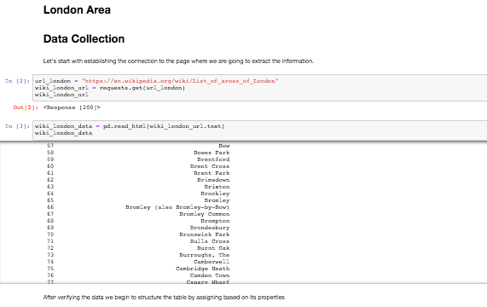
Data Collection

Slide 8
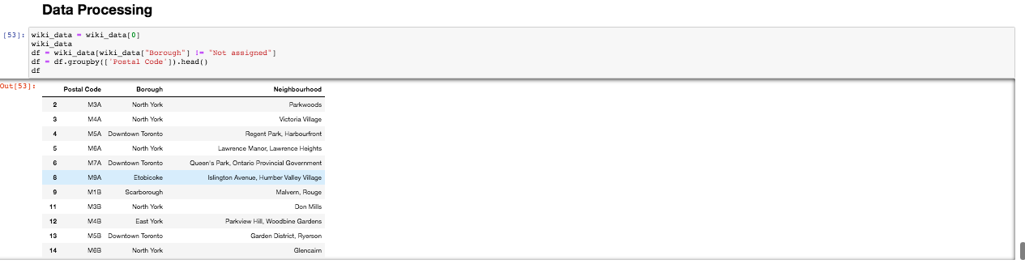
Data Processing

Slide 9
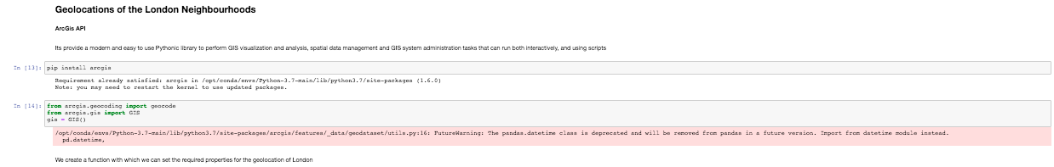
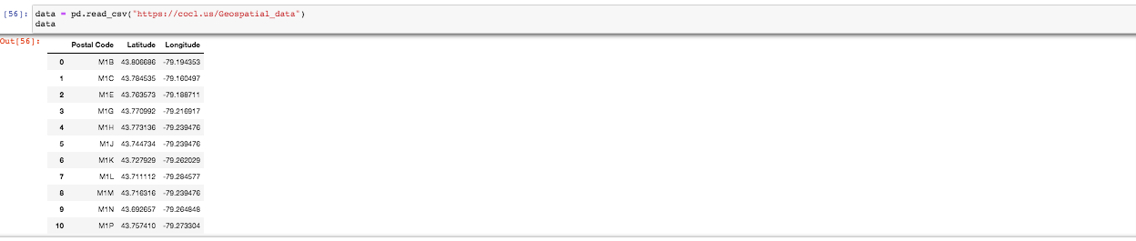
Geolocation

Slide 10

FOURSQUARE

Slide 11
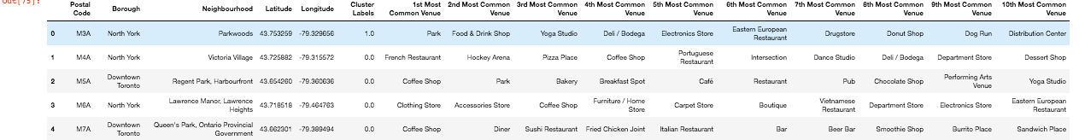
FOURSQUARE(Category Venues)

Slide 12
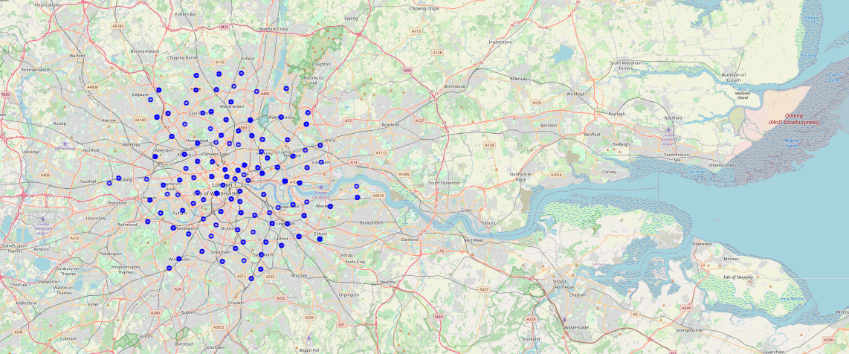
London Map

Slide 13
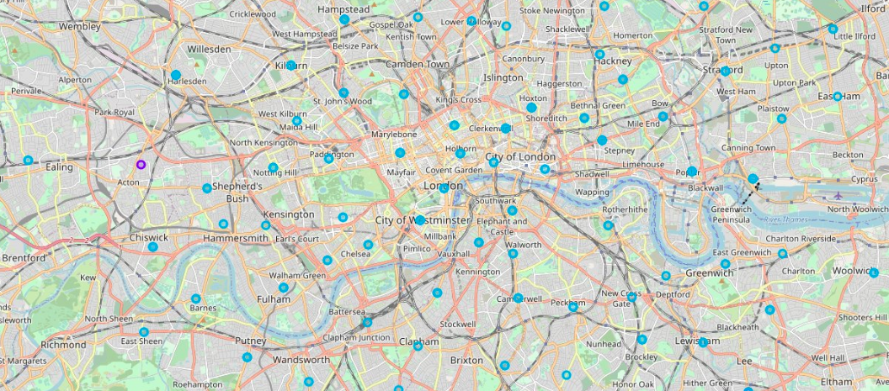
London Map

Slide 14
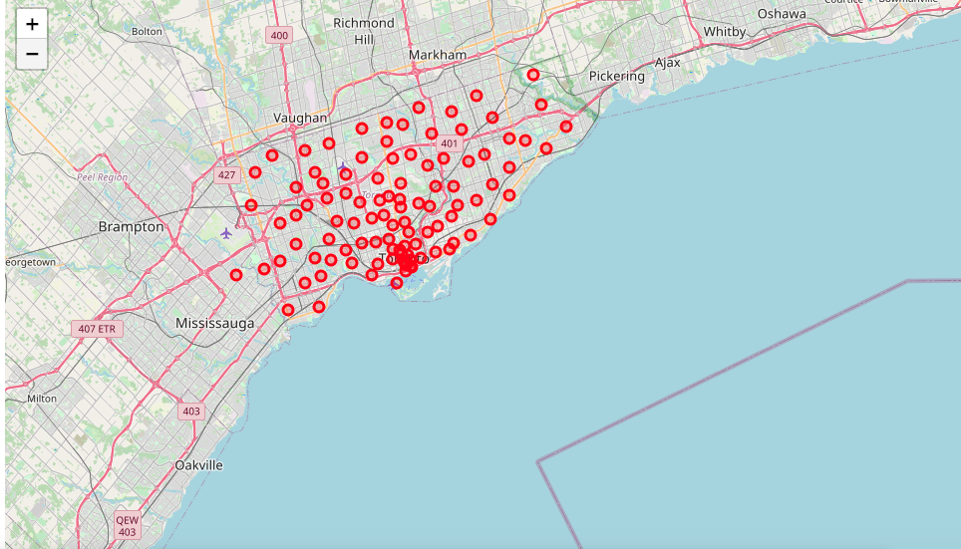
Toronto Map

Slide 15
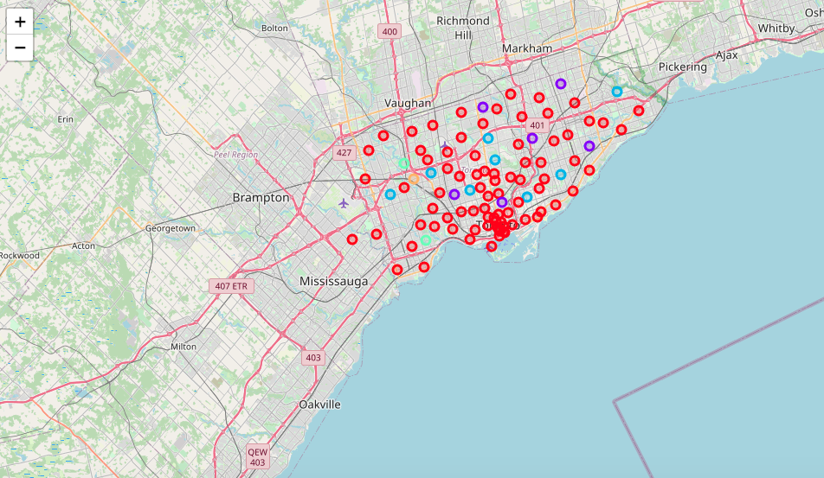
Toronto Map

Slide 16
Results and Discussion
Particularly in our focus on restaurants, both cities have an interesting variety of gastronomic options.In London the international restaurants are mostly of Indian origin or Mediterranean food where only less than 10 Latin restaurants were found all within 5-8 miles of each other. Of the Latin restaurants in London only 1 specializes in Caribbean food. In Toronto there is a little more gastronomic offer than in London. Especially in the Caribbean food restaurants section I could identify about 7 restaurants, in particular 1 of Cuban origin. Therefore, the offer of Caribbean food consumption in Toronto is much more notable than in London

Slide 17
Conclusion
So it would be wiser to start my business in Toronto, as it is a city where I can have more opportunity to generate income and establish myself more easily. However, I would never rule out in the future having a franchise of my business in London where I can grow the taste for Caribbean food in the residents and visitors.

